Slide 1
Linear regression
Overview
Machine learning

Slide 2
What is linear regression?
A linear regression is a data plot that graphs the linear relationship between an independent and a dependent variable(s).
It is typically used to visually show the strength of the relationship, and the dispersion of results.
E.g. to see test the strength of the relationship between amount of ice cream eaten and obesity.
Take the independent variable, the amount of ice cream, and relate it to the dependent variable, obesity, to see if there was a relationship.

Slide 3
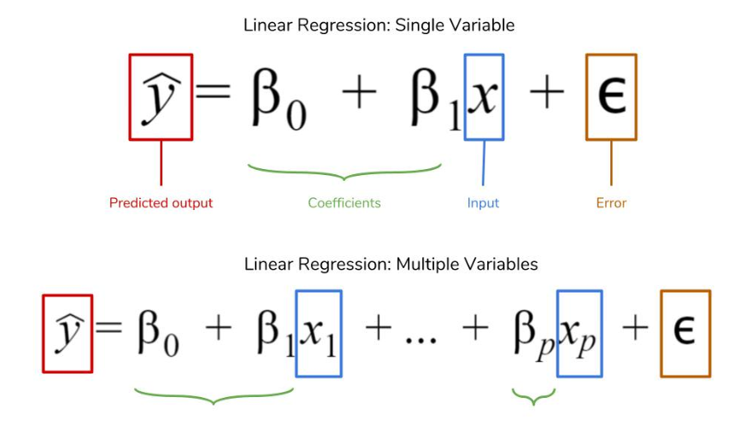
Mathematical form

Slide 4
What do we use linear regression for?
The overall idea of linear regression is to examine 2 things:
Does a set of predictor variables do a good job in predicting an outcome (dependent) variable?
Which variables in particular are significant predictors of the outcome variable and in what way do they –indicated by the magnitude and sign of the beta estimates– impact the outcome variable?

Slide 5
Key points …
When selecting the model for the analysis, an important consideration is model fitting.
Adding independent variables to a linear regression model will always increase the explained variance of the model (typically expressed as R²).
overfitting can occur by adding too many variables to the model, which reduces model generalizability.
A simple model is usually preferable to a more complex model.
Statistically, if a model includes a large number of variables, some of the variables will be statistically significant due to chance alone.

Slide 6
SIMPLE LINEAR REGRESSION
A college bookstore must order books 2 months before each semester starts. They believe that the number of books that will be sold for any particular course is related to the number of students registered for the course when the books are ordered.
They would like to develop a linear regression equation to help plan how many books to order.
From past records, the bookstore obtains the number of
students registered, X, and the number of books actually sold
for a course, y for 12 different semesters.
Semester | No of students | Books
1 | 36 | 31
2 | 28 | 29
3 | 35 | 34
4 | 39 | 35
5 | 30 | 29
6 | 30 | 30
7 | 31 | 30
8 | 38 | 38
9 | 36 | 34
10 | 38 | 33
11 | 29 | 29
12 | 26 | 26

Slide 7
What is the error term?
An error term is a variable in a statistical or mathematical model, which is created when the model does not fully represent the actual relationship between the independent variables and the dependent variables.
The error term is also known as the residual, disturbance, or remainder term.

Slide 8
What is the error term?
Within a linear regression model tracking a stock’s price over time, the error term is the difference between the expected price at a particular time and the price that was actually observed.
In instances where the price is exactly what was anticipated at a particular time, the price will fall on the trend line and the error term will be zero.
Points that do not fall directly on the trend line exhibit the fact that the dependent variable, in this case, the price, is influenced by more than just the independent variable, representing the passage of time.
The error term stands for any influence being exerted on the price variable, such as changes in market sentiment.

Slide 9
error calculation
The residual is calculated as: r_{i} = y_{i} - ŷ
where
r_{i} = residual value
y_{i} = observed value for a given x value
ŷ = predicted value for a given x value
linear equation is ŷ = 1x + 2, the residual for each observation can be found.
For the first set, the actual y value is 1, but the predicted y value given by the equation is
ŷ = 1(1) + 2 = 3. The residual value is, therefore, 1 – 3 = -2, a negative residual value
The magnitude of a typical residual can give us a sense of generally how close our estimates are.
The smaller the residual standard deviation, the closer is the fit to the data.
In effect, the smaller the residual standard deviation is compared to the sample standard deviation, the more predictive, or adequate, the model is.
X | Y | ŷ | error | error²
1 | 1 | 3 | -2 | 4
2 | 4 | 4 | 0 | 0
3 | 6 | 5 | 1 | 1
4 | 7 | 6 | 1 | 1
Sum of squared residuals: 6
Number of residuals less 1: 4 – 1 = 3
Residual standard deviation: √(6/3) = √2 ≈ 1.4142

Slide 10
Loss function
Every machine learning problem is basically an optimization problem.
The function that you want to optimize is usually called the loss function (or cost function).
For the house price prediction example, after the model is trained, we are able to predict new house prices based on their features.
For each house price we predict, denoted as Ŷi, and the actual house price Yi we can calculate the loss by: loss_{i} = ( Ŷ_{i}– Y_{i})²
Which simply defines that our model’s loss is the sum of distances between the house price we’ve predicted and the ground truth.
This loss function, in particular, is called quadratic loss or least squares.
We wish to minimize the loss function (L) as much as possible so the prediction will be as close as possible to the ground truth.
L = ∑( Ŷ_{i}– Y_{i})²

Slide 11
Regression line
Obtain a scatter plot of the number of books sold versus the number of registered students.

Slide 12
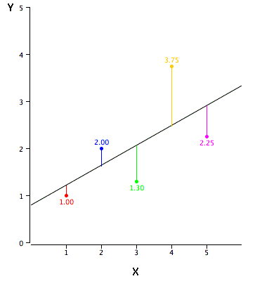
Comparing model predictions against reality
Response = (Constant + Predictors) + Error
Response/output is estimated for any given input or set of inputs
Check these estimated outputs against the actual values
The difference between the actual value and the model's estimate a residual.
These residuals will play a significant role in judging the usefulness of a model.
If the residuals are small, it implies that the model is a good estimator
residual

Slide 13
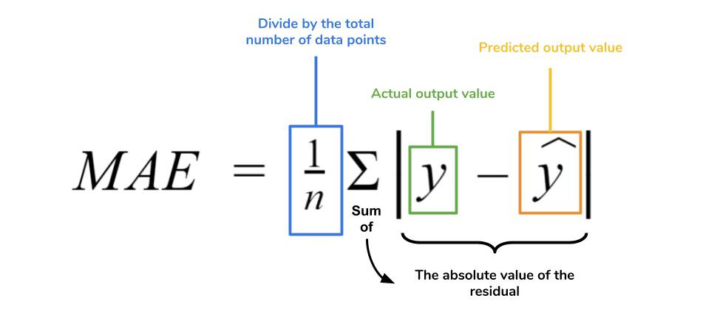
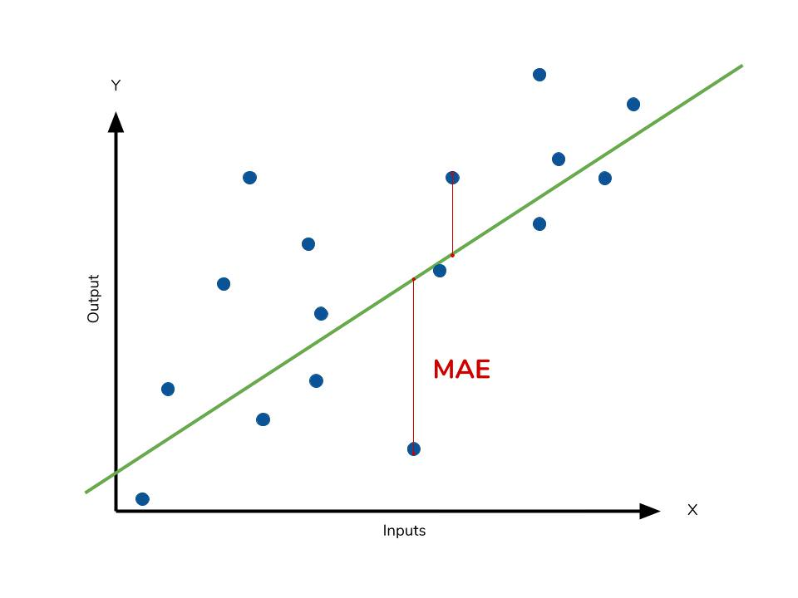
Mean absolute error
Calculate the residual for every data point, taking only the absolute value of each so that negative and positive residuals do not cancel out.
Take the average of all these residuals.
Effectively, MAE describes the typical magnitude of the residuals.

Slide 14
Mean absolute error
The MAE is also the most intuitive of the metrics
Each residual contributes proportionally to the total amount of error, meaning that larger errors will contribute linearly to the overall error.
A small MAE suggests the model is great at prediction, while a large MAE suggests that your model may have trouble in certain areas.
A MAE of 0 means that your model is a perfect predictor of the outputs (but this will almost never happen).

Slide 15
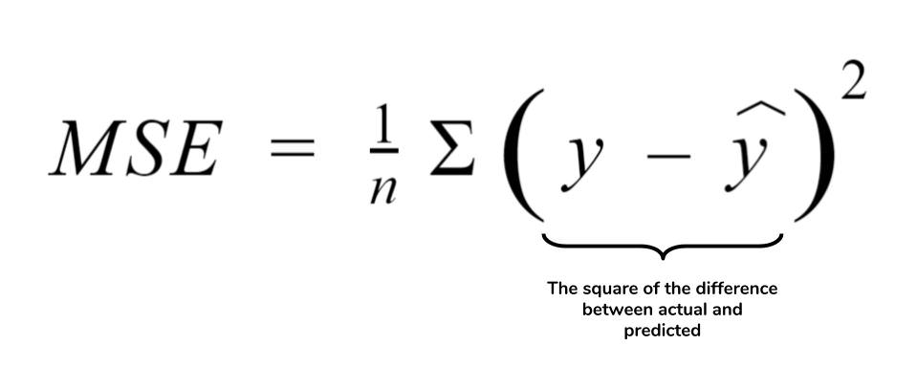
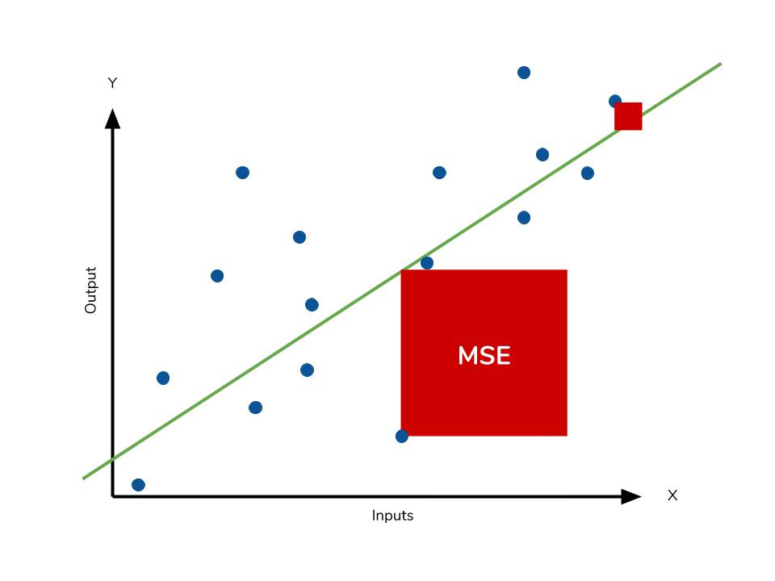
Mean square error
The mean square error (MSE) is just like the MAE but squares the difference before summing them all instead of using the absolute value.

Slide 16
Mean square error
Because we are squaring the difference, the MSE will almost always be bigger than the MAE.
For this reason, we cannot directly compare the MAE to the MSE.
The effect of the square term in the MSE equation is most apparent with the presence of outliers in our data.
Each residual in MAE contributes proportionally to the total error, the error grows quadratically in MSE.
Outliers in our data will contribute to much higher total error in the MSE than they would the MAE.

Slide 17

root mean squared error (RMSE)
Square root of the MSE
Since the MSE and RMSE both square the residual, they are similarly affected by outliers.
The RMSE is analogous to the standard deviation (MSE to variance)
Is a measure of how large your residuals are spread out.

Slide 18
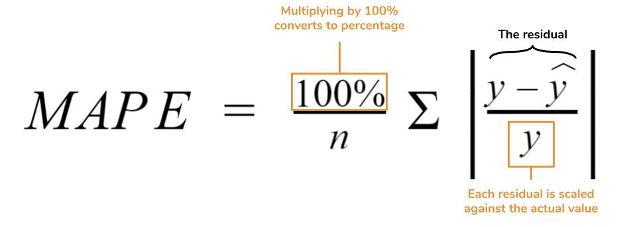
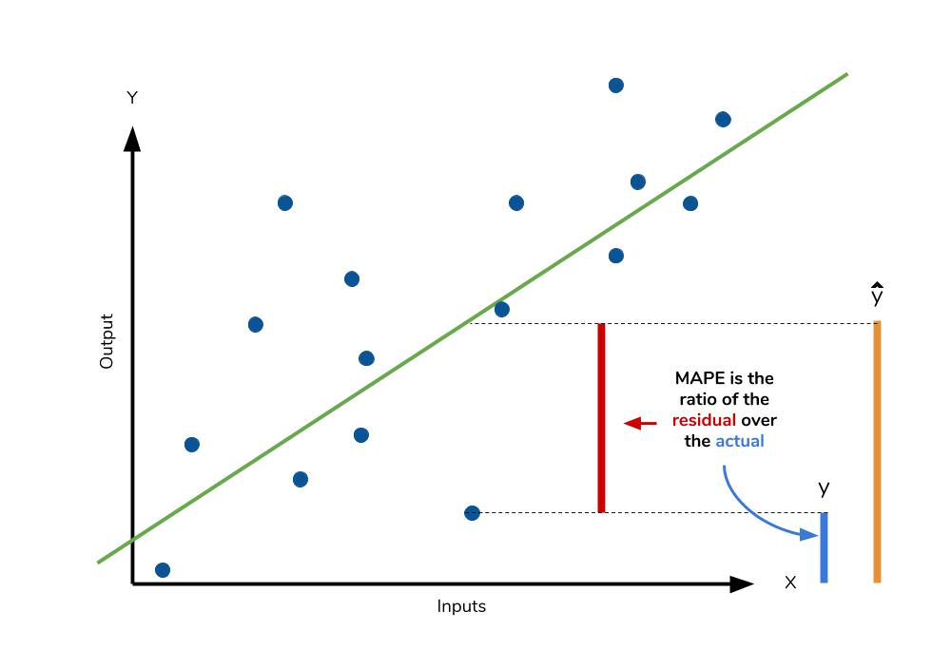
Mean absolute percentage error
The mean absolute percentage error (MAPE) is the percentage equivalent of MAE.
The equation looks just like that of MAE, but with adjustments to convert everything into percentages.
Both MAPE and MAE are robust to the effects of outliers thanks to the use of absolute value.

Slide 19
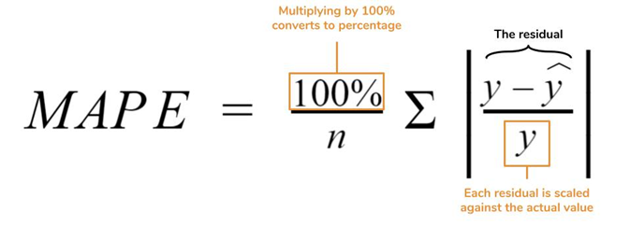
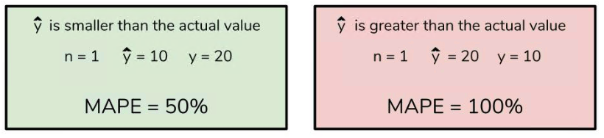
Mean absolute percentage error
MAPE's weaknesses actually stem from use of division operation.
MAPE is undefined for data points where the value is 0.
Similarly, the MAPE can grow unexpectedly large if the actual values are exceptionally small themselves.
Finally, the MAPE is biased towards predictions that are systematically less than the actual values themselves. That is to say, MAPE will be lower when the prediction is lower than the actual compared to a prediction that is higher by the same amount.

Slide 20
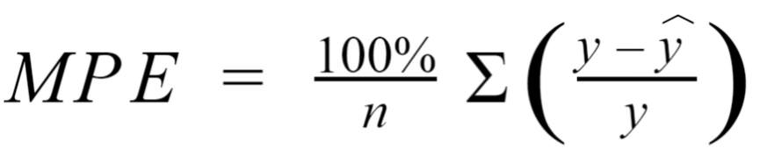
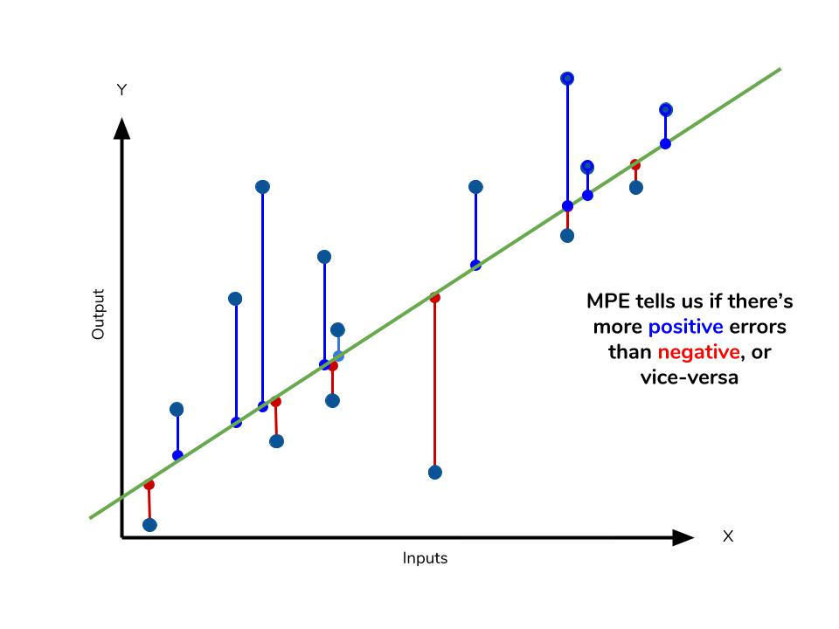
Mean percentage error
The mean percentage error (MPE) equation is exactly like that of MAPE.
The only difference is that it lacks the absolute value operation.

Slide 21
Mean percentage error
Since positive and negative errors will cancel out, we cannot make any statements about how well the model predictions perform overall.
However, if there are more negative or positive errors, this bias will show up in the MPE.
Unlike MAE and MAPE, MPE is useful to us because it allows us to see if our model systematically underestimates (more negative error) or overestimates (positive error).

Slide 22
Residual plot
After you fit a regression model, it is crucial to check the residual plots.
If the plots display unwanted patterns, you can’t trust the regression coefficients and other numeric results.
Residual plots display the residual values on the y-axis and fitted values, or another variable, on the x-axis.

Slide 23
essential parts of a regression model
Dependent Variable = (Constant +Independent Variables) + Error
Or:
Dependent Variable = Deterministic + Stochastic
Stochastic just means unpredictable.
the difference between the expected value and the observed value.
series of errors, should look random
deterministic component is the portion of the variation in the dependent variable that the independent variables explain.
all of the explanatory power should reside here.

Slide 24
R-squared
Is a goodness-of-fit measure for linear regression models.
Indicates the % of the variance in the dependent variable that the independent variables explain collectively.
R-squared measures the strength of the relationship between your model and the dependent variable on a convenient 0 – 100% scale.
the R² is always going to be between -∞ and 1
Small R-squared values are not always a problem, and high R-squared values are not necessarily good!

Slide 25
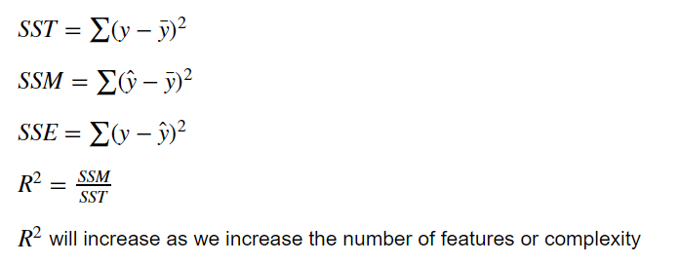
R2 - interpretation
Refer to python code
ML-LINREG-01-r2-adj-r2

Slide 26
exercise
X | Y
1 | 8
2 | 8
3 | 8
4 | 8
5 | 8
6 | 8
7 | 8
8 | 8
9 | 8
10 | 8
R2 of this linear regression line is?

Slide 27
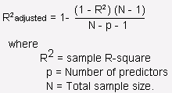
Adjusted r2

Slide 28
Interpret P-values and Coefficients
P-values and coefficients in regression analysis work together to tell which relationships in the model are statistically significant and the nature of those relationships.
The coefficients describe the mathematical relationship between each independent variable and the dependent variable.
The p-values for the coefficients indicate whether these relationships are statistically significant.
After fitting a regression model, check the residual plots first to be sure that we have unbiased estimates. After that, it’s time to interpret the statistical output.

Slide 29
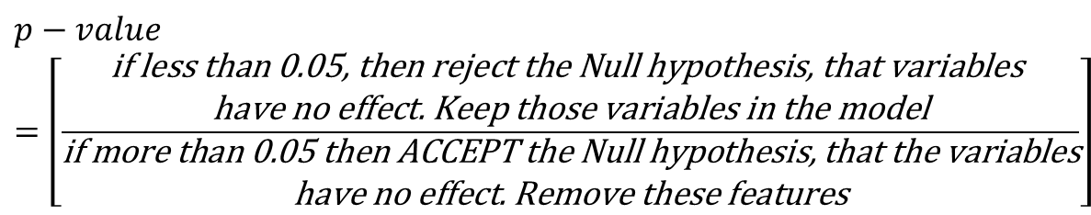
Basically …
Regression analysis is a form of inferential statistics.
The p-values help determine whether the relationships observed in the sample also exist in the larger population.
The p-value for each independent variable tests the null hypothesis that the variable has no correlation with the dependent variable. (no effect)
$$p−value=\left[\frac{\begin{matrix}\text{if} \text{less} \text{than}\text{ 0.05, }\text{then} \text{reject} \text{the} \text{Null} \text{hypothesis}\text{, }\text{that} \text{variables} \\ \text{have} \text{no} \text{effect}\text{. }\text{Keep} \text{those} \text{variables} \text{in} \text{the} \text{model}\end{matrix}}{\begin{matrix}\text{if} \text{more} \text{than}\text{ 0.05 }\text{then} \text{ACCEPT} \text{the} \text{Null} \text{hypothesis}\text{, }\text{that} \text{the} \text{variables} \\ \text{have} \text{no} \text{effect}\text{. }\text{Remove} \text{these} \text{features}\end{matrix}}\right]$$

Slide 30
Summary
Acronym | Residual Operation? | Robust To Outliers? | Key Observations (pros) | Key Observations (cons)
MAE Mean Absolute Error | Absolute Value | Yes | Mean magnitude of the residuals larger errors will contribute linearly to the overall error. small MAE suggests the model is great at prediction | does not indicate if the model under or overshoots actual data). large MAE suggests that your model may have trouble in certain areas

Slide 31
Summary
Acronym | Residual Operation? | Robust To Outliers? | Key Observations (pros) | Key Observations (cons)
MSE Mean Squared Error | Square | No | Analogous to variance | error grows quadratically Overestimating badness Metric worsens with the square term in case of few outliers even a “perfect” model may have a high MSE in case of noisy data underestimate badness ALL the errors are small

Slide 32
Summary
Acronym | Residual Operation? | Robust To Outliers? | Key Observations (pros) | Key Observations (cons)
RMSE Root Mean Squared Error | Square | No | a close relative of MSE, can compare models using MSE Analogous to SD | affected by the outliers

Slide 33
Summary
Acronym | Residual Operation? | Robust To Outliers? | Key Observations (pros) | Key Observations (cons)
MAPE Mean Absolute Percentage Error | Absolute Value | Yes | percentage equivalent of MAE | undefined for data points where the value is 0 can grow unexpectedly large if the actual values are exceptionally small themselves biased towards predictions that are systematically less than the actual values

Slide 34
Summary
Acronym | Full Name | Residual Operation? | Robust To Outliers? | Key Observations (pros) | Key Observations (cons)
MPE | Mean Percentage Error | N/A | Yes | more negative or positive errors, this bias will show up in the MPE Tells if our model systematically underestimates (more negative error) or overestimates (positive error). | Since positive and negative errors cancel out, cannot make any statements about how well the model predictions perform overall

Slide 35
parameters
sklearn.linear_model.LinearRegression(fit_intercept=True,
normalize=False,
copy_X=True,
n_jobs=None)
Parameters
fit_intercept | boolean, optional, default True whether to calculate the intercept for this model. If set to False, no intercept will be used in calculations
normalize | boolean, optional, default False If True, the regressors X will be normalized before regression by subtracting the mean and dividing by the l2-norm. If you wish to standardize, please use sklearn.preprocessing.StandardScaler before calling fit on an estimator with normalize=False.

Slide 36
Important Points:
There must be linear relationship between independent and dependent variables
Multiple regression suffers from multicollinearity, autocorrelation, heteroskedasticity.
Linear Regression is very sensitive to Outliers. It can terribly affect the regression line and eventually the forecasted values.
Multicollinearity can increase the variance of the coefficient estimates and make the estimates very sensitive to minor changes in the model. The result is that the coefficient estimates are unstable
In case of multiple independent variables, go with forward selection, backward elimination and step wise approach for selection of most significant independent variables.

Slide 37
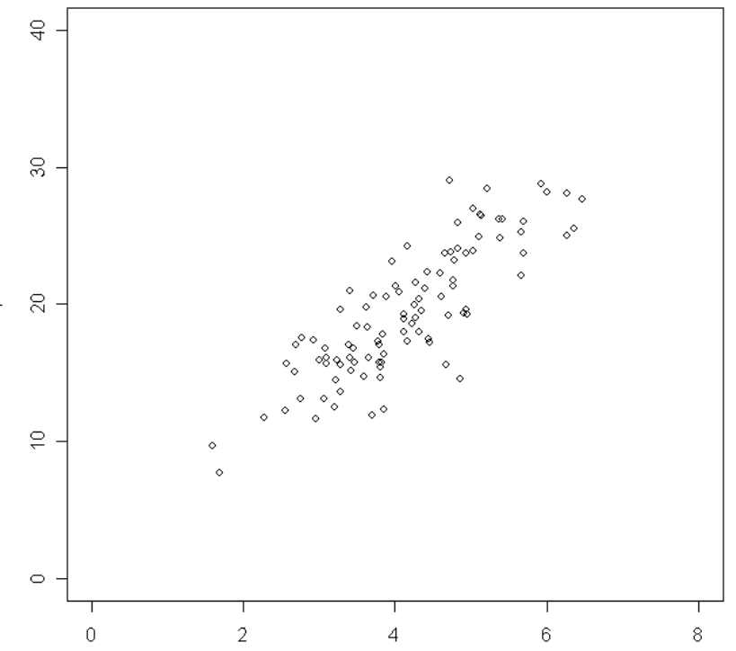
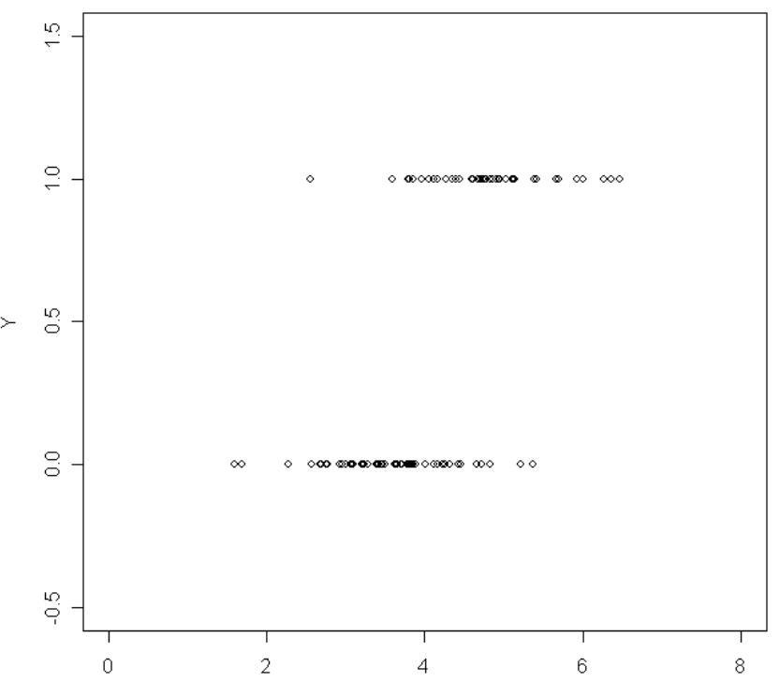
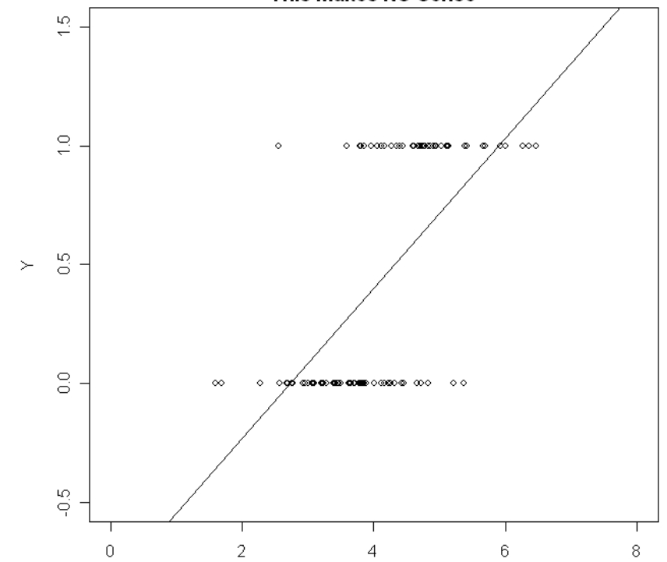
When to use lin reg
the error term Epsilon has a normal distribution with mean 0 and standard deviation
This means the output y, must be continuous variable (i.e., one that takes values on an interval), not a binary variable
where,
are the regression slope coefficients,
are the corresponding values of the X-variables,
is the intercept, and
is the random error term.
The least-squares regression line gives predictions that make no sense.
For example, for an X value of 8, the least-square regression line predicts that Y will be above 1.5.
But Y can only take on values of 0 and 1.

Slide 38
Assumptions
Criteria
Number of observations | the observation-to-Independent Variables (IVs) ratio should ideally be 20:1; that is 20 cases for every IV in the model. For 10 IV, total sample size min 200
Accuracy of data | Pandas (describe method) at least check the minimum and maximum value for each variable to ensure that all values for each variable are valid.
Missing data | Consider imputation (In case of few values being missing)
Outliers | An outlier is often operationally defined as a value that is at least 3 SD above or below the mean. delete those cases. recode the value
Linearity | Use bivariate scatterplots to check. Look for residual vs fitted value plots
Heteroscedasticity of residuals | One of the important assumptions of linear regression is that, there should be no heteroscedasticity of residuals. In simpler terms, this means that the variance of residuals should not increase with fitted values of response variable.

Slide 39
Assumptions
Criteria
Normality | construct histograms and "look" at the data to see its distribution.
Multicollinearity | Multicollinearity is a condition in which the IVs are very highly correlated (.90 or greater) Ordinary Least square method cannot be that effective. deleting one of the two variables (after careful analysis) Statistically, regression coefficients is calculated through matrix inversion. if multicollinearity exists the inversion is unstable.
Transformations | one or more variables are not normally distributed, you might want to transform them harder to interpret the analysis

Slide 40
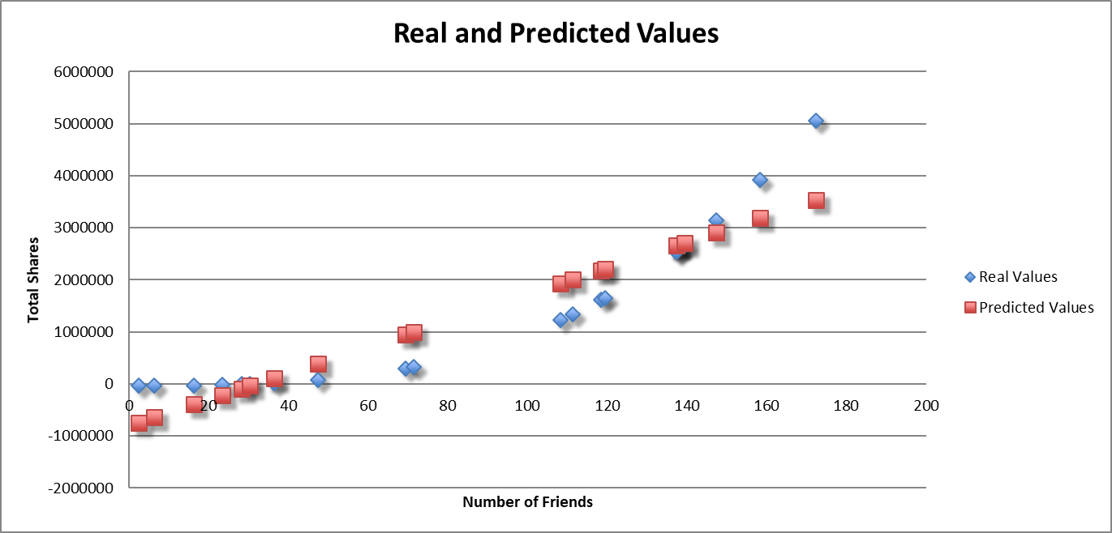
When, why and how should use linear regression
The relationship between the variables is linear.
variance in the residuals (the difference in the real and predicted values) is more or less constant.
The residuals are independent, meaning the residuals are distributed randomly and not influenced by the residuals in previous observations.
The residuals are normally distributed. This assumption means the

Slide 41
Use cases
Sales of a product; pricing, performance, and risk parameters
Generating insights on consumer behavior, profitability, and other business factors
Evaluation of trends; making estimates, and forecasts
Determining marketing effectiveness, pricing, and promotions on sales of a product
Assessment of risk in financial services and insurance domain
Studying engine performance from test data in automobiles
Calculating causal relationships between parameters in biological systems
Conducting market research studies and customer survey results analysis
Astronomical data analysis
Predicting house prices with the increase in sizes of houses
stock trading, video games, sports betting, and flight time prediction.

Slide 42
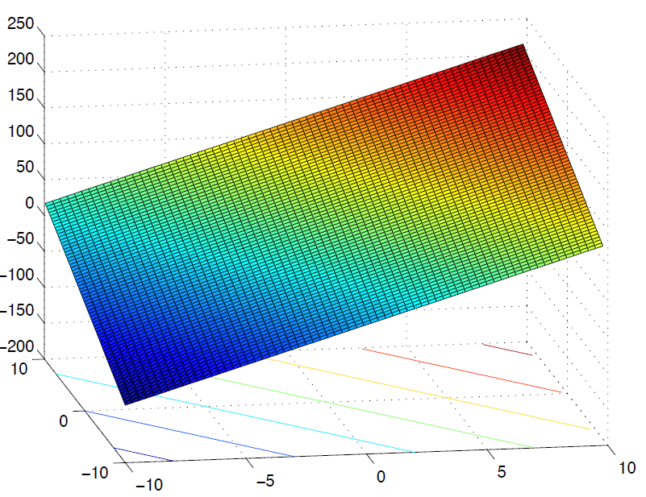
geometric intuition
Models with 2 predictor variables (say x₁ and x₂) and a response variable y can be understood as a two-dimensional surface in space.
The observations are points in space and the surface is “fitted” to best approximate the observations.
Simplest multiple regression model for 2 predictor variables is
y = β₀ + β₁x₁ + β₂x₂ + ε
The surface that corresponds to the model
y = 50 +10x₁ + 7x₂ looks like this.
It is a plane in R3 with different slopes in x₁ and x₂

Slide 43
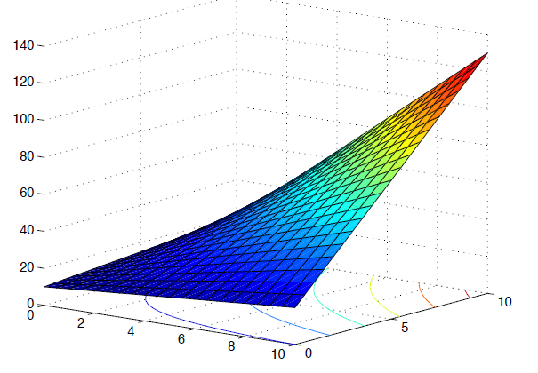
geometric intuition
For a simple linear model with two predictor variables and an interaction term, the surface is no longer flat but curved.
y = 10 + x₁ + x₂ + x₁x₂

Slide 44
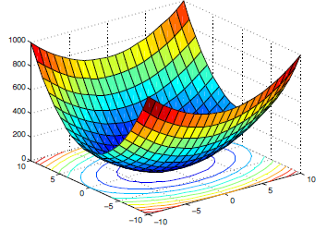
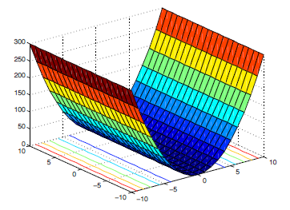
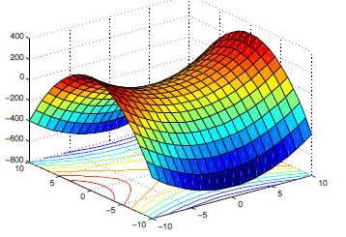
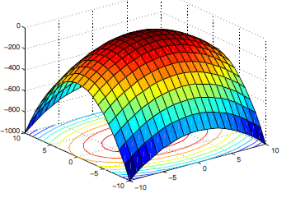
geometric intuition
Polynomial regression models with 2 predictor variables and interaction terms are quadratic forms.
Their surfaces can have many different shapes depending on the values of the model parameters with the contour lines being either parallel lines, parabolas or ellipses.
y = β₀ + β₁X₁ + β₂X₂ + β₁₁X₂¹ + β₂₂X₂² + β₁₂X₁X₂ + ε

Slide 45
qs
Linear Regression is a supervised machine learning algorithm.
A) TRUE
B) FALSE
Which of the following methods do we use to find the best fit line for data in Linear Regression?
A) Least Square Error
B) Maximum Likelihood
C) Logarithmic Loss
D) Both A and B

Slide 46
qs
Which of the following evaluation metrics can be used to evaluate a model while modeling a continuous output variable?
A) AUC-ROC
B) Accuracy
C) Logloss
D) Mean-Squared-Error
Which of the following is true about Residuals ?
A) Lower is better
B) Higher is better
C) A or B depend on the situation
D) None of these

Slide 47
qs
Suppose that we have N independent variables (X1,X2… Xn) and dependent variable is Y. Now Imagine that you are applying linear regression by fitting the best fit line using least square error on this data.
You found that correlation coefficient for one of it’s variable(Say X1) with Y is -0.95.
Which of the following is true for X1?
A) Relation between the X1 and Y is weak
B) Relation between the X1 and Y is strong
C) Relation between the X1 and Y is neutral
D) Correlation can’t judge the relationship

Slide 48
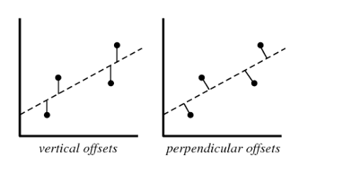
qs
Which of the following offsets, do we use in linear regression’s least square line fit? Suppose horizontal axis is independent variable and vertical axis is dependent variable.
A) Vertical offset
B) Perpendicular offset
C) Both, depending on the situation
D) None of above

Slide 49
qs
Which of the following statement is true about outliers in Linear regression?
A) Linear regression is sensitive to outliers
B) Linear regression is not sensitive to outliers
C) Can’t say
D) None of these
Suppose you plotted a scatter plot between the residuals and predicted values in linear regression and you found that there is a relationship between them. Which of the following conclusion do you make about this situation?
A) Since the there is a relationship means our model is not good
B) Since the there is a relationship means our model is good
C) Can’t say
D) None of these

Slide 50
qs
What will happen when you fit degree 4 polynomial in linear regression?
A) There are high chances that degree 4 polynomial will over fit the data
B) There are high chances that degree 4 polynomial will under fit the data
C) Can’t say
D) None of these
Now we increase the training set size gradually. As the training set size increases, what do you expect will happen with the mean training error?
A) Increase
B) Decrease
C) Remain constant
D) Can’t Say

Slide 51
Qs 2
At a .01 level of significance is there sufficient evidence to conclude that the number of books sold is related to the number of registered students in a straight-line manner?
H₀: The number of students registered and the number of books sold are not correlated
H_{a}: The number of students registered and the number of books sold are correlated
Decision Rule: Accept Ha if the calculated p-value < .01
Test Statistic: r = the Pearson coefficient of correlation
Calculations : r = 0.8997,
r² = 0.80
p-value < 0.0001 < .01 (α )
Interpretation: At the .01 level of significance , the probability that observed values can be found (H_{O} = true) is very very less than given α . Reject H_{O.} Hence there is strong relation between number of students and books

Slide 52
Qs 3
Carefully explain what the p-value found, means.
H₀: The number of students registered and the number of books sold are not correlated
H_{a}: The number of students registered and the number of books sold are correlated
Decision Rule: Accept Ha if the calculated p-value < .01
Test Statistic: r = the Pearson coefficient of correlation
Calculations : r = 0.8997,
r² = 0.80
p-value < 0.0001 < .01 (α )
Interpretation: At the .01 level of significance , the probability that observed values can be found (H_{O} = true) is very very less than given α . Reject H_{O.} Hence there is strong relation between number of students and books

Slide 53
Qs 4
interpret the strength of the straight-line relationship.
Coefficient of determination
r² = .809 (80.9%).
80.9% of the variability in the number of books sold is explained by the straight-line relationship with the number of registered students.
19.1% of this variability is unexplained, and due to error.
This relationship is quite strong.

Slide 54
Qs 5
Give the regression equation, and interpret the coefficients in terms of this problem..
When no students have registered for a course, the number of books sold is 9.30 (or about 9). This is the starting point of the straight-line when x = 0.
It is not particularly meaningful in this problem since all the classes sampled had more than 25 students registered.
For each additional student registered for a course, the number of books sold increases by 0.673.

Slide 55
Qs 6
predict the number of books that would be sold in a semester when 30 students have registered. Use 95% confidence...
Since 30 students is within the range of the sampled number of students, it is appropriate to make this prediction.
From excel, the calculated prediction interval is (25.865078, 33.09856).
95% confident that for a course that has 30 students registered the bookstore will sell between 25.9 and 33.1 books.
Y-pred = 29.48181818

Slide 56
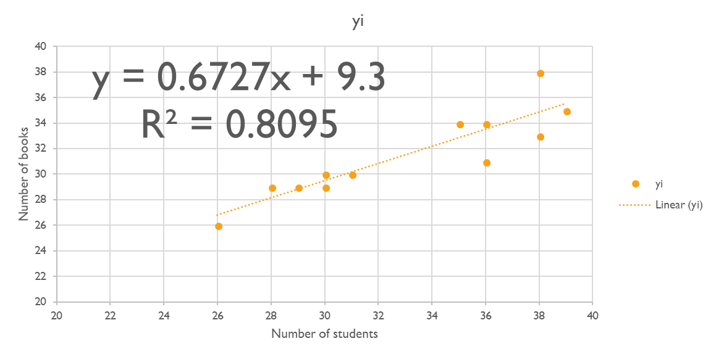
Qs 7
If appropriate, predict the number of books that would be sold in a semester when 5 students have registered. Use 95% confidence.
Since 5 students is not within the range of the sampled number of students, it is not appropriate to use the regression equation to make this prediction.
We do not know if the straight-line model would fit data at this point, and we should not extrapolate.

Slide 57
P-values
Hypothesis tests are used to test the validity of a claim that is made about a population.
This claim that’s on trial, in essence, is called the null hypothesis. (H_{o})
The alternative hypothesis is the one you would believe if the null hypothesis is concluded to be untrue. (H_{a})
The p-value, or calculated probability, is the probability of finding the observed, or more extreme, results when the null hypothesis (H_{o}) of a study question is true
All hypothesis tests ultimately use a p-value to weigh the strength of the evidence (what the data are telling about the population).
The null hypothesis is usually an hypothesis of "no difference" e.g. no difference between blood pressures in group A and group B.

Slide 58
P-values
The p-value is a number between 0 and 1 and interpreted in the following way:
A small p-value (typically ≤ 0.05 or α = 5% = .05) indicates strong evidence against the null hypothesis, so you reject the null hypothesis.
A large p-value (> 0.05) indicates weak evidence against the null hypothesis, so you fail to reject the null hypothesis.
p-values very close to the cutoff (0.05) are considered to be marginal (could go either way).

Slide 59
example
For example, suppose a pizza place claims their delivery times are 30 minutes or less on average but you think it’s more than that.
You conduct a hypothesis test with some sample data.
null hypothesis, H_{o} = mean delivery time is 30 minutes max
alternative hypothesis (H_{a}) = mean time is greater than 30 minutes.
After the test, the p-value turns out to be 0.001, which is much less than 0.05. ( α )
It means there is only a probability of 0.001 that we will find observed instances when H_{o} = true. Hence reject H_{o} as it is << α

